Slide 1
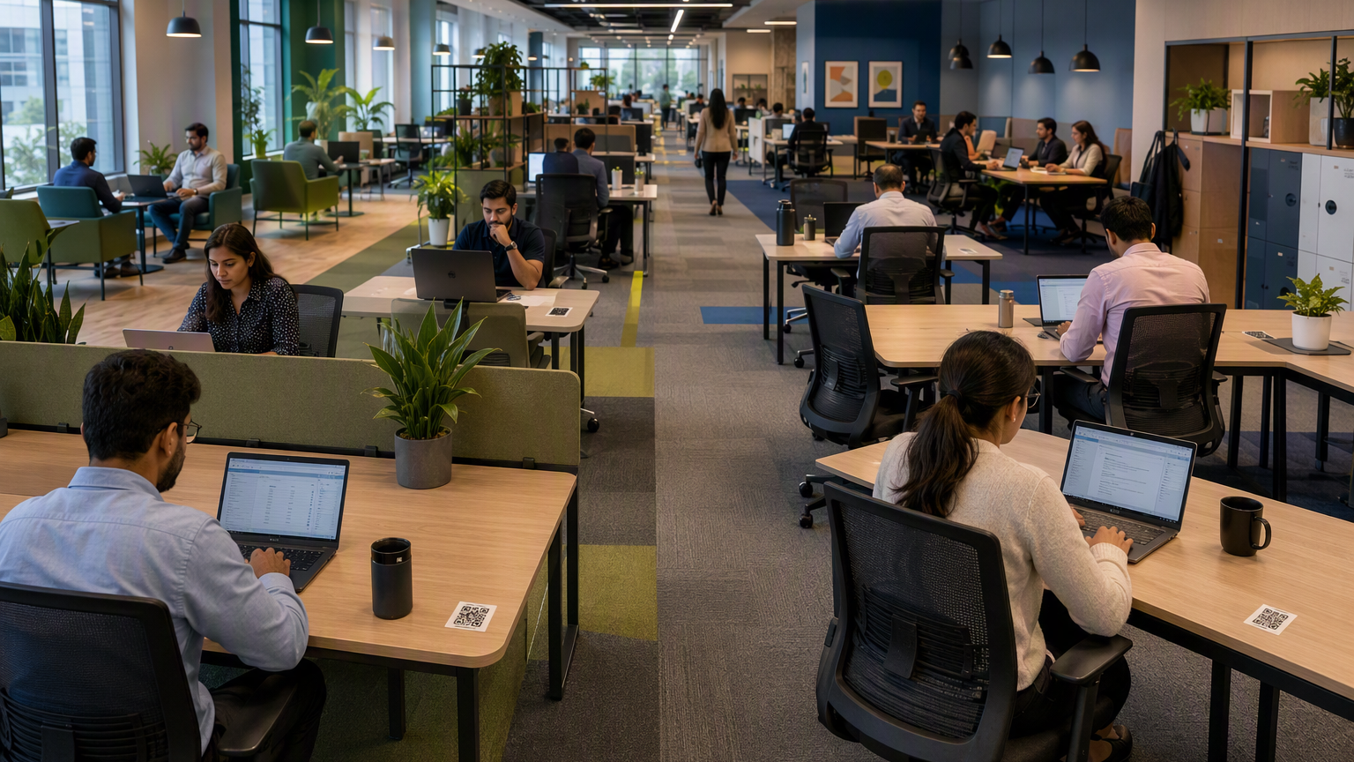
Idea proposal
Smart Workspace
Management
QR + ID swipe + LAN signal + calendar intelligence to optimize desk usage, employee experience, and facilities cost.
Live seat availability
Team co-location
Auto-release unused seats
Facilities cost optimization
Notes:
Generated by Microsoft Copilot. [Sources] Visual on this slide was generated with Microsoft Copilot. Concept based on user-provided rough idea in this conversation.

Slide 2
Executive overview
A single workplace intelligence layer for occupancy, allocation, and operations.
Problem
Approach
Decision logic
Business value
Static allocation does not reflect actual hybrid attendance or shift demand.
Fuse QR scan, ID swipe, LAN connection, calendar context, and reminders.
Keep seats occupied only when the employee is actually using or intentionally holding the desk.
Improve employee seat discovery while reducing wasted desks and facility spend.
20–30%
10–18%
45 min
5
Desk inventory optimization
Ops cost reduction potential
No-show release policy
Primary validation signals
Cost figures are an estimate range for business-case discussion. Final value should be validated using actual desk count, lease/opex, utility, housekeeping, pantry, and adoption data.
Notes:
Generated by Microsoft Copilot. [Sources] Internal document <File>Smart Workspace Allocation and access management.docx</File> says the solution should help managers and facilities allocate seats efficiently, monitor real-time utilization, support hot seat booking, and use access swipe data to validate occupancy, shift patterns, and access compliance (turn1search25 lines 2-4). Vizitor hot desking ROI article recommends calculating ROI from current desks, peak-day occupancy plus buffer, and fully loaded per-desk annual cost, rather than copying a generic percentage (turn1search1).

Slide 3
Why this is needed
Hybrid attendance creates avoidable space waste unless office seating is managed using actual usage signals.
Current challenges
Opportunity
Cab booking is useful but incomplete because employees may use personal commute.
Use ID swipe as the strongest office-presence signal.
Assigned/static seats do not reveal real occupancy or no-shows.
Use QR scan to map employee ↔ desk ↔ zone.
Managers lack a practical view of where team members are seated.
Use LAN connection as desk-occupancy evidence.
Facilities operate power, HVAC, pantry, and housekeeping without zone-level demand intelligence.
Use calendar and reminders to avoid unfair auto-release.
Access violations require manual validation and follow-up.
Use dashboards and reports to right-size seats by team, day, shift, floor, and zone.
Notes:
Generated by Microsoft Copilot. [Sources] Internal document <File>Smart Workspace Allocation and access management.docx</File> states actual office attendance and seat utilization vary significantly across teams and shifts (turn1search25 line 2). Internal document <File>Smart Workspace Allocation and access management.docx</File> lists impacted groups including employees, managers, facilities, security/access management, housekeeping, pantry, maintenance, and leadership (turn1search25 line 3).

Slide 4
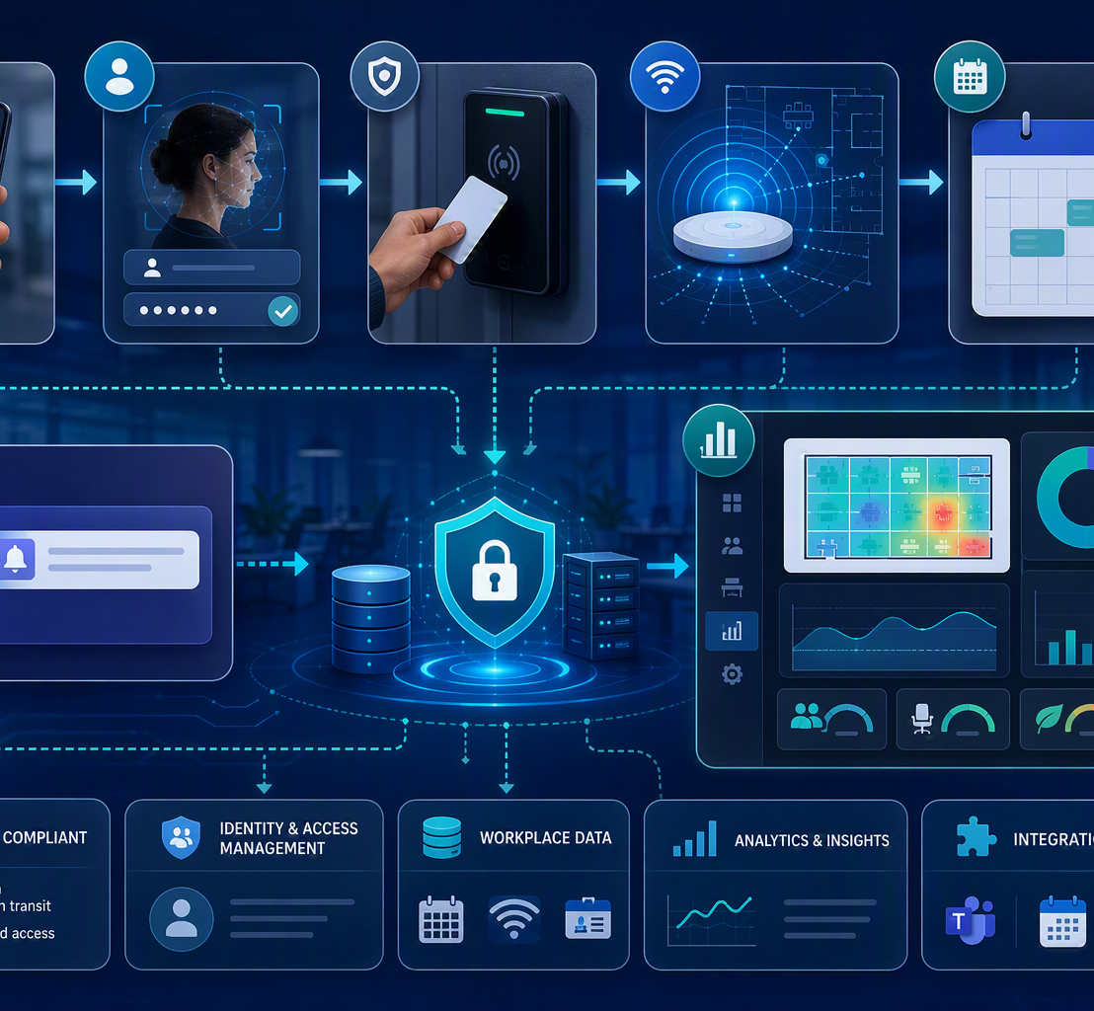
Proposed solution architecture
A signal-fusion model improves accuracy while keeping the QR experience simple.
Data signals
QR scan: desk, workstation, zone ID
Okta-authenticated user claims
ID card swipe: office presence validation
LAN connection: desk occupancy evidence
Calendar: meeting-aware release exceptions
Teams/Slack bot: confirmation and alerts
Core services
Occupancy engine
Seat allocation rules
Notification workflow
Analytics and dashboards
Notes:
Generated by Microsoft Copilot. [Sources] Visual on this slide was generated with Microsoft Copilot. User rough idea proposes QR codes at each desk and authentication through Okta after the URL opens. User rough idea proposes ID card swipe and LAN connection as stronger occupancy signals.

Slide 5
Employee journey and authentication
The QR code is only the entry point. Identity is validated through Okta authorization flow.
1
2
3
4
5
6
Scan desk QR
Check authenticated session
Redirect to Okta if needed
Read user claims
Map desk to employee
Update dashboard
Single-tenant Okta
Multi-tenant option
Everyone belongs to one organization tenant. The backend redirects unauthenticated users to the configured authorization endpoint and uses claims like email/name/group after login.
If multiple customer organizations exist, the QR URL can include tenant ID or the user email domain can route to the correct Okta organization.
Notes:
Generated by Microsoft Copilot. [Sources] User rough idea describes QR code as a URL and authentication happening after the user opens the URL. User rough idea recommends OAuth Authorization Code Flow and notes user details can be retrieved from ID token or userinfo endpoint.

Slide 6
Desk occupancy and release logic
A fair release algorithm prevents phantom occupancy while protecting legitimate meeting scenarios.
Desk booked or scanned
Swipe-in exists?
LAN active?
Inactive 45 min?
Calendar conflict?
Notify user / release
Release rules
Governance guardrails
Release if no swipe-in after configured grace period.
Use clear employee communication before enforcing auto-release.
Release if LAN is inactive beyond 45 minutes and no valid hold signal exists.
Keep privacy by limiting reporting to operational need.
Pause release if employee is in a scheduled meeting.
Allow manager review for access violation workflow.
Send heartbeat reminder for unscheduled meeting or ambiguous absence.
Maintain audit trail for release, override, and notification actions.
Notes:
Generated by Microsoft Copilot. [Sources] User rough idea proposes unlocking a desk when LAN is not connected for a stipulated time, with 45 minutes as an example. User rough idea proposes calendar check and heartbeat-style reminders before releasing a desk.

Slide 7
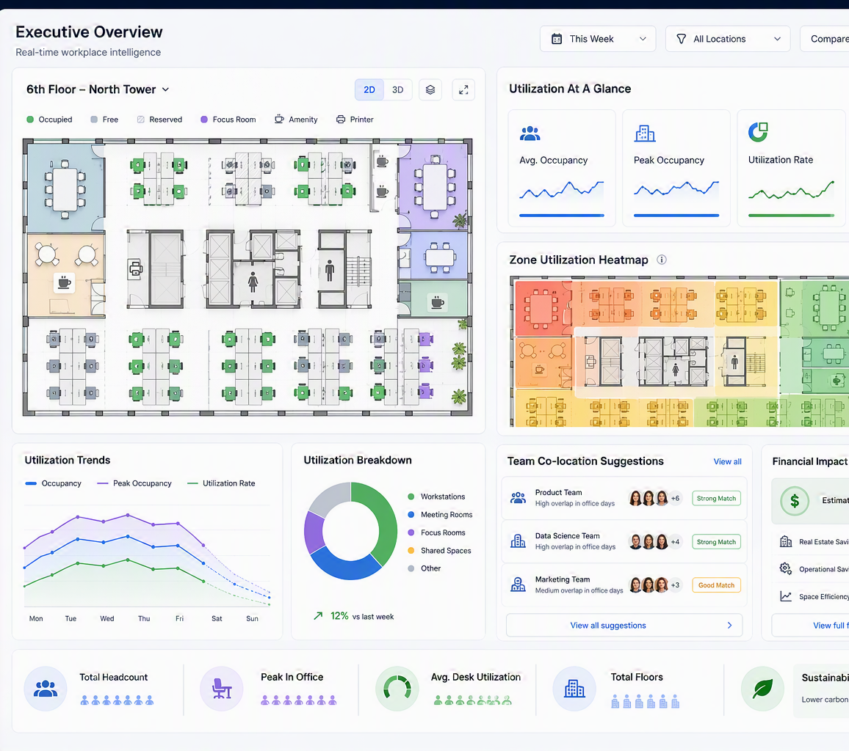
Live dashboards and reporting
Facility teams and managers get a practical, role-based view of availability, utilization, and exceptions.
Dashboard views
✓
Floor/wing/zone-wise availability
✓
Seat numbering and layout map
✓
Manager seat allocation view
✓
Employee hot seat booking
✓
Swipe-in validation against booking
✓
Utilization by team, shift, floor, zone
✓
Access violation workflow queue
Notes:
Generated by Microsoft Copilot. [Sources] Visual on this slide was generated with Microsoft Copilot. Internal document <File>Smart Workspace Allocation and access management.docx</File> lists suggested features including floor/wing/zone-wise dashboard, manager view, hot seat booking, layout view, swipe-in validation, shift pattern identification, access violation workflow, and utilization reports (turn1search25 line 4).

Slide 8
AI-assisted workplace experience
AI makes the system proactive, not just transactional.
AI
Employee Copilot
AI
Manager Copilot
AI
Facilities Copilot
Suggest nearest available seat near teammates.
Plan team co-location by sprint/project days.
Predict zone load by day and shift.
Remember favorite seat traits such as window/friends/team zone.
Identify teams repeatedly split across zones.
Identify underused zones and overused amenities.
Recommend adjacent seats when team cluster is visible.
Assign new joiners near buddy or manager.
Tune housekeeping/pantry/HVAC based on demand.
Reduce desk-hunting time on peak days.
Approve exceptions faster with context.
Highlight access anomalies for validation.
Notes:
Generated by Microsoft Copilot. [Sources] User rough idea proposes AI to suggest where teammates are seated and whether adjacent seats are available. User rough idea proposes favorite seat identification based on preferences such as friends, teammates, or window seat.

Slide 9

Cost-cutting potential
The financial case comes from reducing unused seat inventory and variable operating inefficiencies.
Illustrative model for 1,000 desks
Current desks
1,000
Verified peak occupancy
650
Planning buffer
10%
Target required seats
715
Potential optimizable desks
285
Fully loaded cost/desk/year
₹45,000
Gross annual opportunity
₹1.28 Cr
Realistic Year-1 captured value
₹0.77–0.96 Cr
Expected cost-cutting level
10–18% facility run-rate reduction potential
Notes:
Generated by Microsoft Copilot. [Sources] Visual on this slide was generated with Microsoft Copilot. Cost model is illustrative and uses assumptions in the slide, not actual company facilities data. Replace values with actual current desks, peak occupancy, buffer, and fully loaded desk cost. Vizitor hot desking ROI article recommends annual savings = desks eliminated × fully loaded per-desk annual cost, with desks eliminated based on current provisioned desks minus peak-day occupancy plus planning buffer (turn1search1). Skedda hot desking guide gives an example of calculating target seats from peak attendance plus buffer and ROI from desks removed multiplied by cost per desk per year (turn1search5).

Slide 10
Expected outcomes coverage
All seven expected outcomes are met by the current solution concept.
Expected outcomes
Why expectations are met
✓
Better visibility into available and occupied seats
QR creates desk-user mapping.
✓
Improved team co-location planning
Swipe-in and LAN signals validate actual presence.
✓
Release of unused booked seats when employees do not swipe in
Calendar and reminder logic reduces false release.
✓
Better shift-based facility planning
Dashboards expose utilization by zone/shift/team.
✓
Reduced power, HVAC, pantry, and housekeeping inefficiencies
Manager approval workflow handles access exceptions.
✓
Automated access violation validation workflow
Historical analytics enable allocation policy changes.
✓
Data-driven seat allocation instead of static quota-based allocation
Notes:
Generated by Microsoft Copilot. [Sources] Internal document <File>Smart Workspace Allocation and access management.docx</File> lists the same expected outcomes in the challenge document (turn1search25 line 4). Coverage assessment is based on mapping the user-provided concept to those listed outcomes.

Slide 11
Suggested features coverage
All suggested features are incorporated, with a few recommended MVP priorities.
Feature incorporation checklist
Recommended additions
Floor/wing/zone-wise seat availability dashboard
No-show policy configuration by site/floor.
✓
MVP
Manager seat allocation view
✓
MVP
Privacy, retention, and audit controls.
Employee hot seat booking
✓
MVP
Accessibility/priority seating workflow.
Seat numbering/layout view
✓
MVP
Manual override for BO/facilities admins.
Swipe-in validation against seat booking
✓
MVP
Shift pattern identification
Exception dashboard for false positives.
✓
Phase 2
Access violation notification and manager approval
✓
MVP
API integration layer for badge, LAN, calendar, HR/asset data.
Utilization reports by team, shift, floor, and zone
✓
MVP
Notes:
Generated by Microsoft Copilot. [Sources] Internal document <File>Smart Workspace Allocation and access management.docx</File> lists suggested features including dashboards, manager views, hot seat booking, layout view, swipe-in validation, shift pattern identification, access violation workflow, and utilization reports (turn1search25 line 4). Recommended additions are solution design suggestions from Microsoft Copilot based on the provided idea and common enterprise controls.

Slide 12
MVP roadmap
Gradually move from visibility to automation to optimization.
1
2
3
4
Phase 1: Foundation
Phase 2: Validation
Phase 3: Automation
Phase 4: Intelligence
QR code generation, desk master, zone master, Okta login, baseline dashboard
Swipe-in match, LAN status ingestion, no-show detection, exception queue
45-minute release, calendar-aware hold, heartbeat reminders, manager approval
AI seat suggestions, favorite-seat patterns, shift forecasting, cost dashboards
MVP recommendation: start with QR + Okta + desk mapping + dashboard + swipe-in validation. Add LAN and calendar-aware release after validating privacy/security and technical feasibility.
Notes:
Generated by Microsoft Copilot. [Sources] MVP roadmap is a Microsoft Copilot recommendation based on the user-provided idea and the internal problem statement mission to create a concept or prototype for intelligent seat allocation, hot seat booking, access-based utilization tracking, and manager-driven governance (turn1search25 line 4).

Slide 13
Decision summary
The idea is strong and covers the requested outcomes and suggested features.
Verdict
What makes it credible
Next inputs needed
Expectations: Met
Suggested features: Incorporated
Cost cutting: Medium to high potential, subject to actual facilities data
Multiple validation signals
Current desk count by floor
Employee-friendly remediation
Peak swipe-in by day/shift
Manager governance loop
Current opex per desk/zone
Actionable dashboards
LAN signal availability/security review
AI-assisted seat recommendations
Privacy and data retention policy
Notes:
Generated by Microsoft Copilot. [Sources] Summary based on mapping the user-provided idea to internal challenge outcomes/features and the illustrative cost model in this deck. Cost estimate should be validated with actual facilities, IT, and finance data before presentation as a committed savings number.

